Slide 1
Social Skills

Slide 2
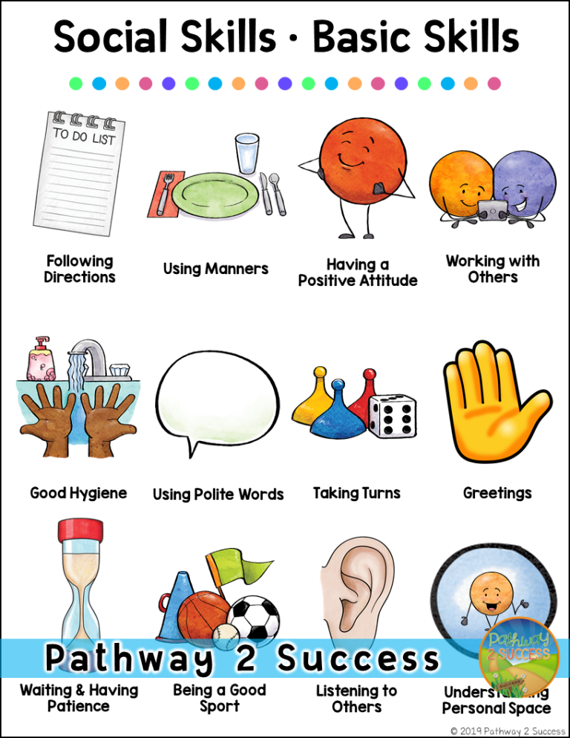

Slide 3
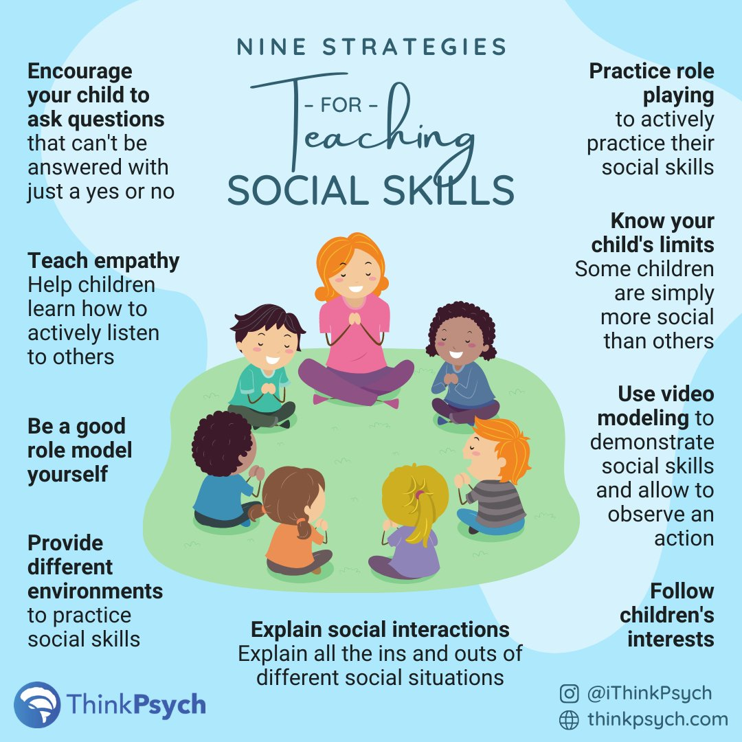

Slide 4
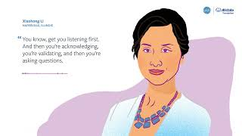
Parent perspective on SEL

Slide 5
Teaching social skills at home
Use modeling to focus on social skills
Taking Turns
Seeing things from someone else’s perspective
Being flexible

Slide 6
Social skills during movie nights
Try a comedy
Set the scene
Keep the remote handy

Slide 7
Other strategies
Focus on strengths
Follow up on consequences for misbehavior
Ask children how they feel
Find ways to stay calm when angry
Be willing to apologize
Give children choices and respect their wishes
Ask questions that help children solve problems on their own
Read books and stories together
Encourage sharing and helping

Slide 11
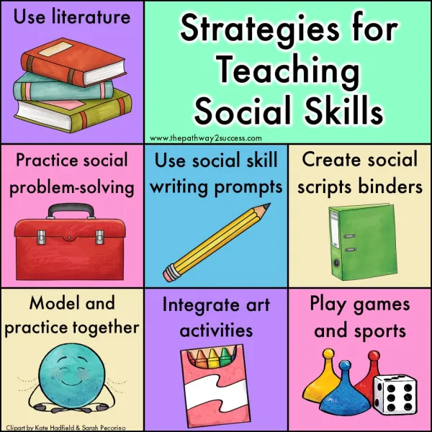

Slide 12
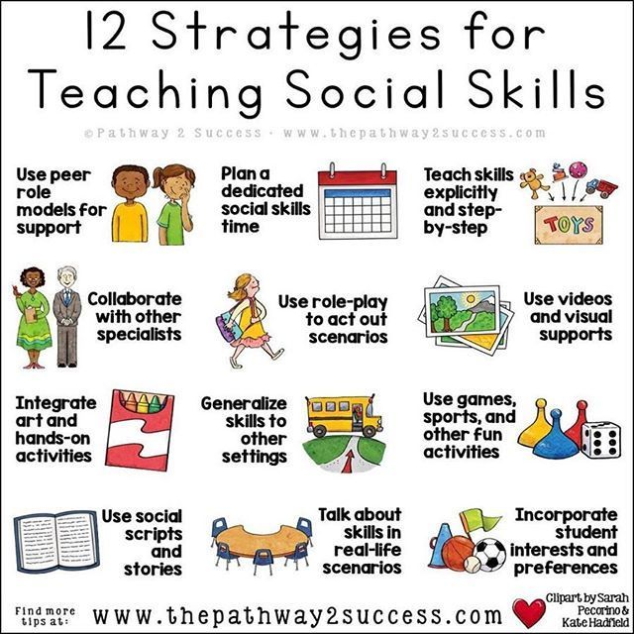

Slide 13
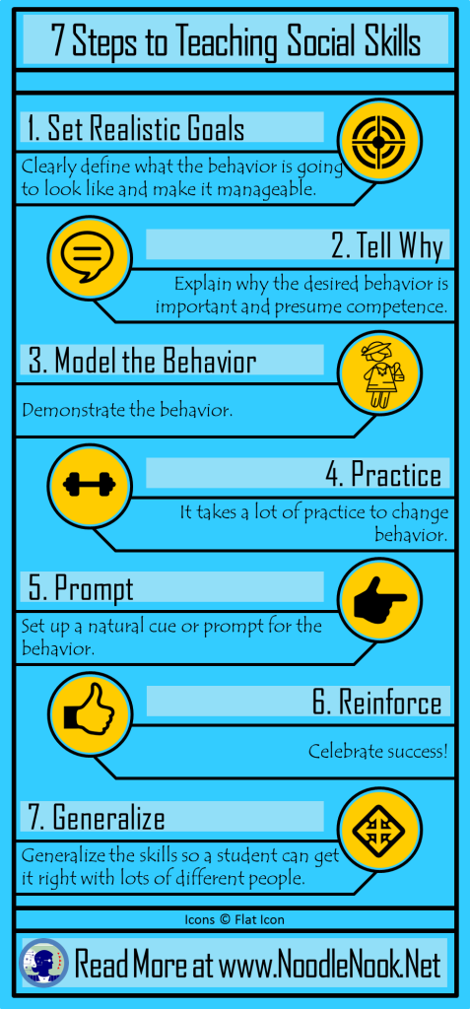

Slide 14
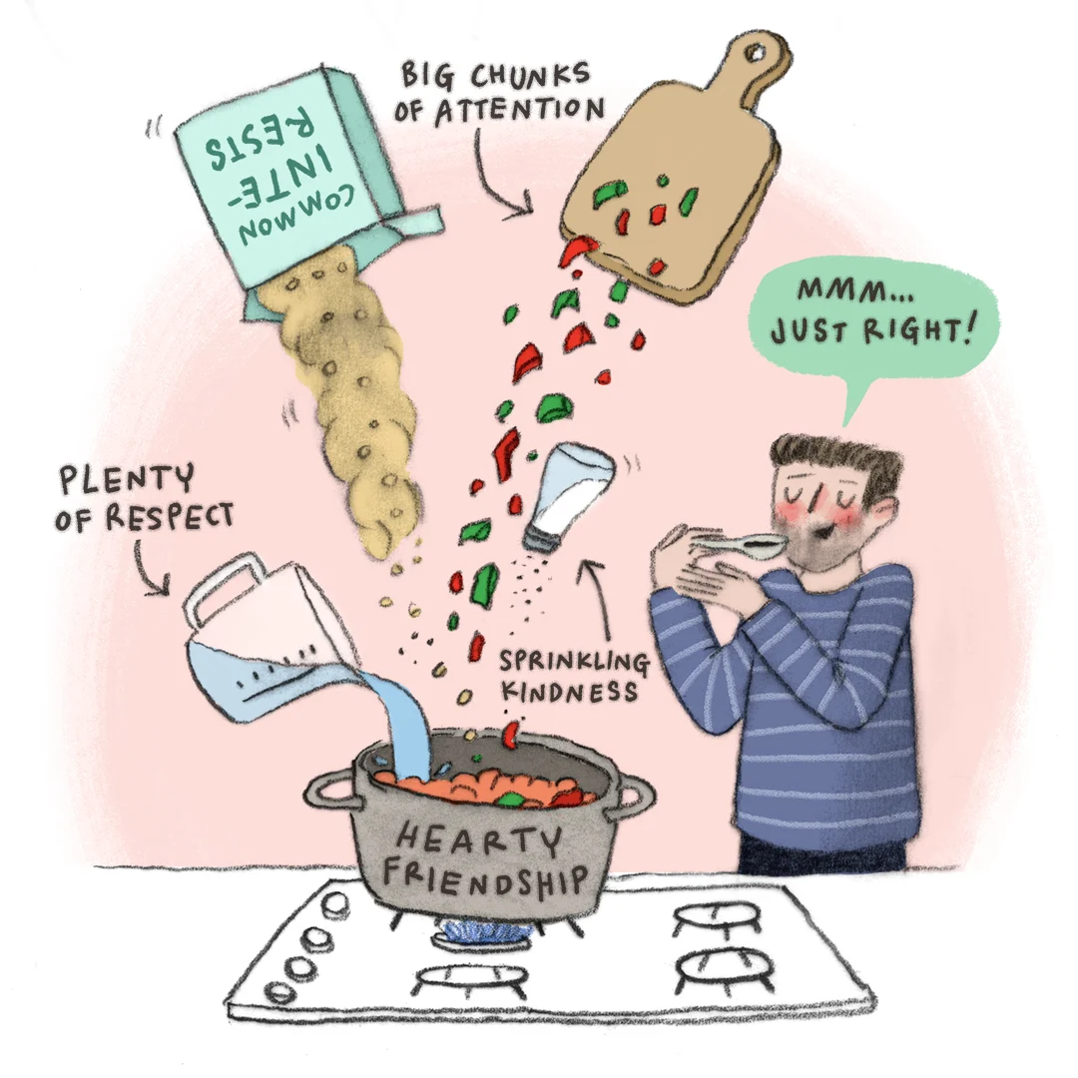
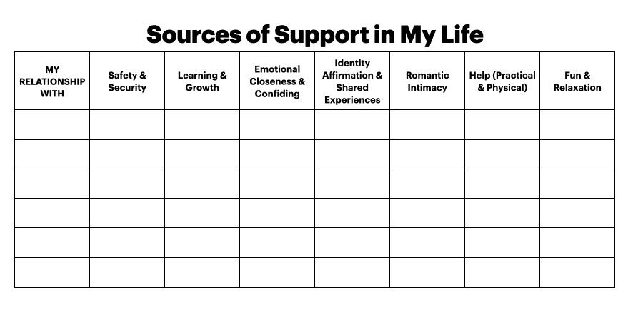
Why are relationships important?
Harvard study

Slide 15
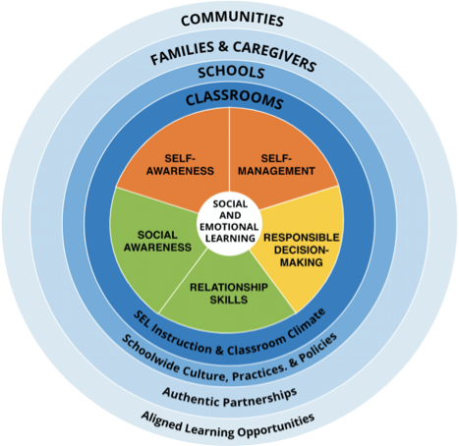
The
CASEL 5...
Five broad and interrelated areas of competence:
Self-awareness
Self-management
Social awareness
Relationship skills
Responsible decision-making
Video overview
@caselorg | #WhatisSEL
Notes:
The CASEL 5 can be taught and applied at various developmental stages from childhood to adulthood and across diverse cultural contexts. Many school districts, states, and countries have used the CASEL 5 to establish preschool to high school learning standards and competencies that articulate what students should know and be able to do for academic success, school and civic engagement, health and wellness, and fulfilling careers.
Updated descriptions of competencies and added additional bulleted examples to reflect the growing research and more inclusive understanding of competence development and SEL as a lever for equity and excellence
Includes attention to children, adolescents, and adults
Note that bullets are examples not exhaustive

Slide 16
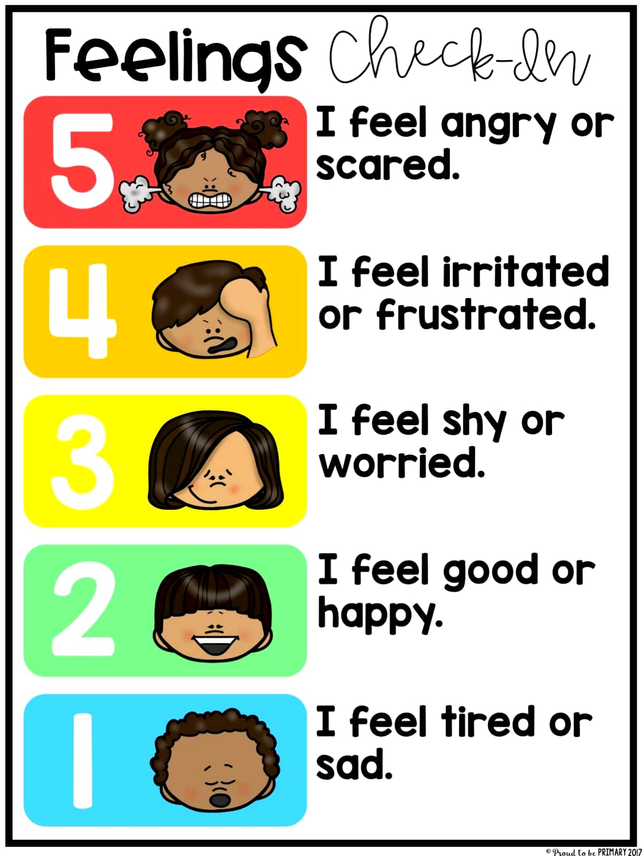
Self Awareness
How are you feeling?
What happened to make you feel this way?
How are you showing your feeling?
What are you doing to feel more, less, or the same of that feeling?

Slide 17
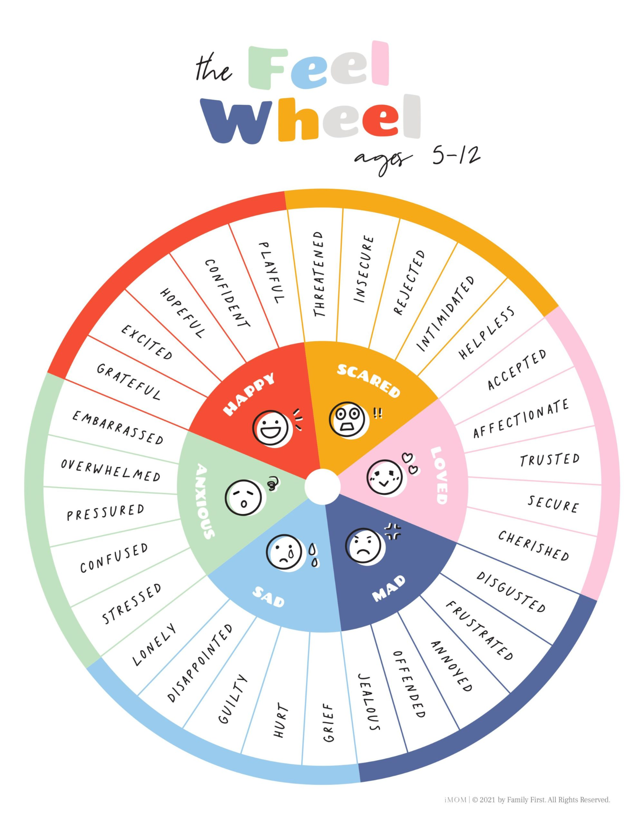

Slide 18
Self Management
Managing one's emotions
Identifying and using stress management techniques
Setting personal goals
Showing the courage to take initiative
Exhibiting self-discipline and self motivation

Slide 19
Toomuchery

Slide 20
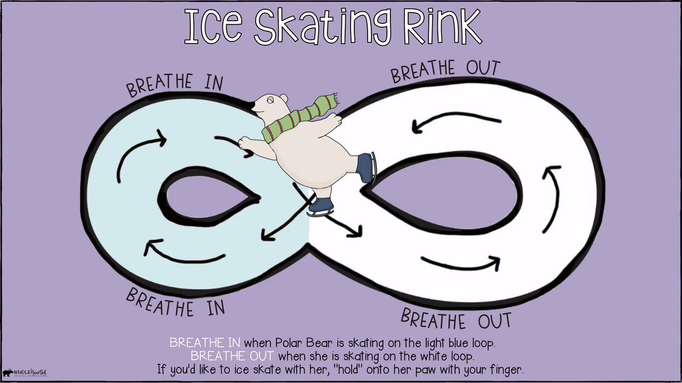
Dealing with Feelings: Self Regulation
Deep Breathing
Positive Affirmations/Positive Self Talk
Asking for Help
Taking a Break
Rapid Reset
Exercise
Practice Gratitude Three things that make me happy
Self Care
Mindfulness: Mindful Moments
Mediation: Headspace Growth Mindset

Slide 21
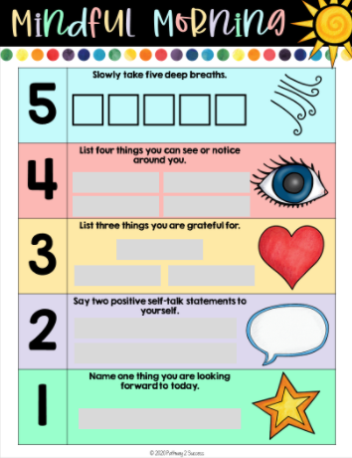
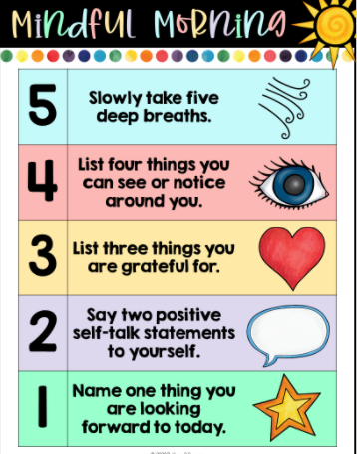

Slide 22
SOCIAL AWARENESS
The abilities to understand the perspectives of and empathize with others, including those from diverse backgrounds, cultures, and contexts. This includes the capacities to feel compassion for others, understand broader historical and social norms for behavior in different settings, and recognize family, school, and community resources and supports.
Such as:
Taking others’ perspectives
Recognizing strengths in others
Demonstrating empathy and compassion
Showing concern for the feelings of others
Understanding and expressing gratitude
Identifying diverse social norms, including unjust ones
Recognizing situational demands and opportunities
Understanding the influences of organizations and systems on behavior
@caselorg | #WhatisSEL
@caselorg | #WhatisSEL
Notes:
Social Awareness: which includes how we understand diverse social norms, including unjust ones, and understand the systemic influences on our behaviors

Slide 23
Social Mind
To read and detect
social cues, to know what others are feeling
D

Slide 24
Big heart
Understand, support, and demonstrate mindfulness
and empathy
D

Slide 25
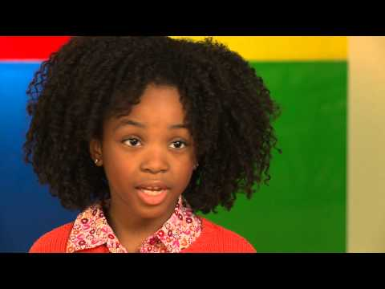
How is she feeling? Why?

Slide 26
Body Language
Facial expressions
Gestures
Posture
Orientation
Attention
Distance

Slide 27
Putting the Pieces Together
Recognize emotions in ourselves and others
Understanding the why we feel how we do, and the consequences
Label our feelings to help us manage them
Expressing our feelings
Learning how to manage our feelings

Slide 28
RELATIONSHIP SKILLS
The abilities to establish and maintain healthy and supportive relationships and to effectively navigate settings with diverse individuals and groups. This includes the capacities to communicate clearly, listen actively, cooperate, work collaboratively to problem solve and negotiate conflict constructively, navigate settings with differing social and cultural demands and opportunities, provide leadership, and seek or offer help when needed.
Such as:
Communicating effectively
Developing positive relationships
Demonstrating cultural competency
Practicing teamwork and collaborative problem-solving
Resolving conflicts constructively
Resisting negative social pressure
Showing leadership in groups
Seeking or offering support and help when needed
Standing up for the rights of others
@caselorg | #WhatisSEL
@caselorg | #WhatisSEL
Notes:
Relationship skills: which includes how we demonstrate cultural competency and stand up for the rights of others
Collaborating
Good relationships
Managing conflict
Showing leadership
seeking/offering help
Standing up for rights of others

Slide 29
Relationship Skills
PBS video

Slide 30
Growth mindset

Slide 31
Parent ideas
Casel Framework applied to home life
More home ideas

